Slide 1
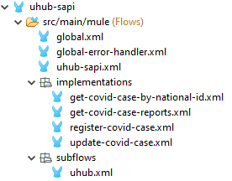
Mule project naming standards and structure
Project name: kebab case (ex: uhub-sapi)
Flow and subflow names: kebab case (ex: register-covid-case)
Property file names: kebab case (ex: uhub-sapi-dev.yaml)
Variable names: camel case (ex: covidCasePayload)
Connector names: Firstletter capital word with space b/w words (ex: Transform Message)
JSON/XML fields: Any on of below
capital camel case: StreetAdress
kebab case: street-address
snake case: sreet_address
camel case: streetAddress

Slide 2
THANK YOU
HAPPY LEARNING ☺

